Slide 1
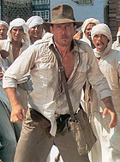

Project -- Knapsack Problem
Dennis J. Zhang
Washington University in St. Louis

Slide 2
Knapsack Problem

Slide 3
Knapsack Problem
Which items should Indiana put in his satchel to maximize value?

Slide 4
Knapsack Instance

Slide 5
Knapsack Instance
In the Project:
C is a function that depends on 4 features
C = g(f_1, f_2, f_3, f_4)
Only find out C once you choose which items to put in the knapsack
If you go over C, then you get nothing for that instance

Slide 6
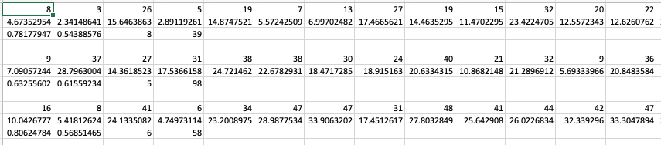
Knapsack Instance
In the Project:
100 Knapsack Instances
C = g(f_1, f_2, f_3, f_4)
Only find out C once you choose which items to put in the knapsack
If you go over C, then you get nothing for that instance
Here is how I’ll give you the knapsack instances
Space.
Instance 1
rewards
Instance 2
features
Instance 3

Slide 7
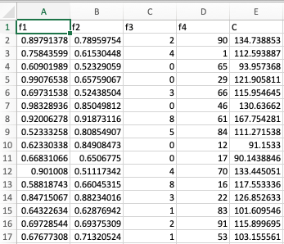
Training Data
You will also have a dataset contains features and bag sizes for you to find the function g().

Slide 8
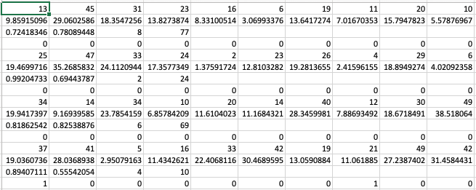
How to Submit
decision
Put your decisions as a binary vector at every 4th row.

Slide 9
Approach
Build a prediction model to find the knapsack size for each instance
Your prediction should be accurate.

Slide 10
Approach
Build a prediction model to find the knapsack size for each instance
Your prediction should be accurate.
Based on your prediction, pick the bag size.

Slide 11
Approach
Build a prediction model to find the knapsack size for each instance
Your prediction should be accurate.
Based on your prediction, pick the bag size.
Find best way to pack knapsack given the picked bag size from prediction.
Develop a few heuristics.
For each instance of the knapsack problem, pass the instance to each heuristic and then pick the best.

Slide 12
Conservative Approach

Slide 13
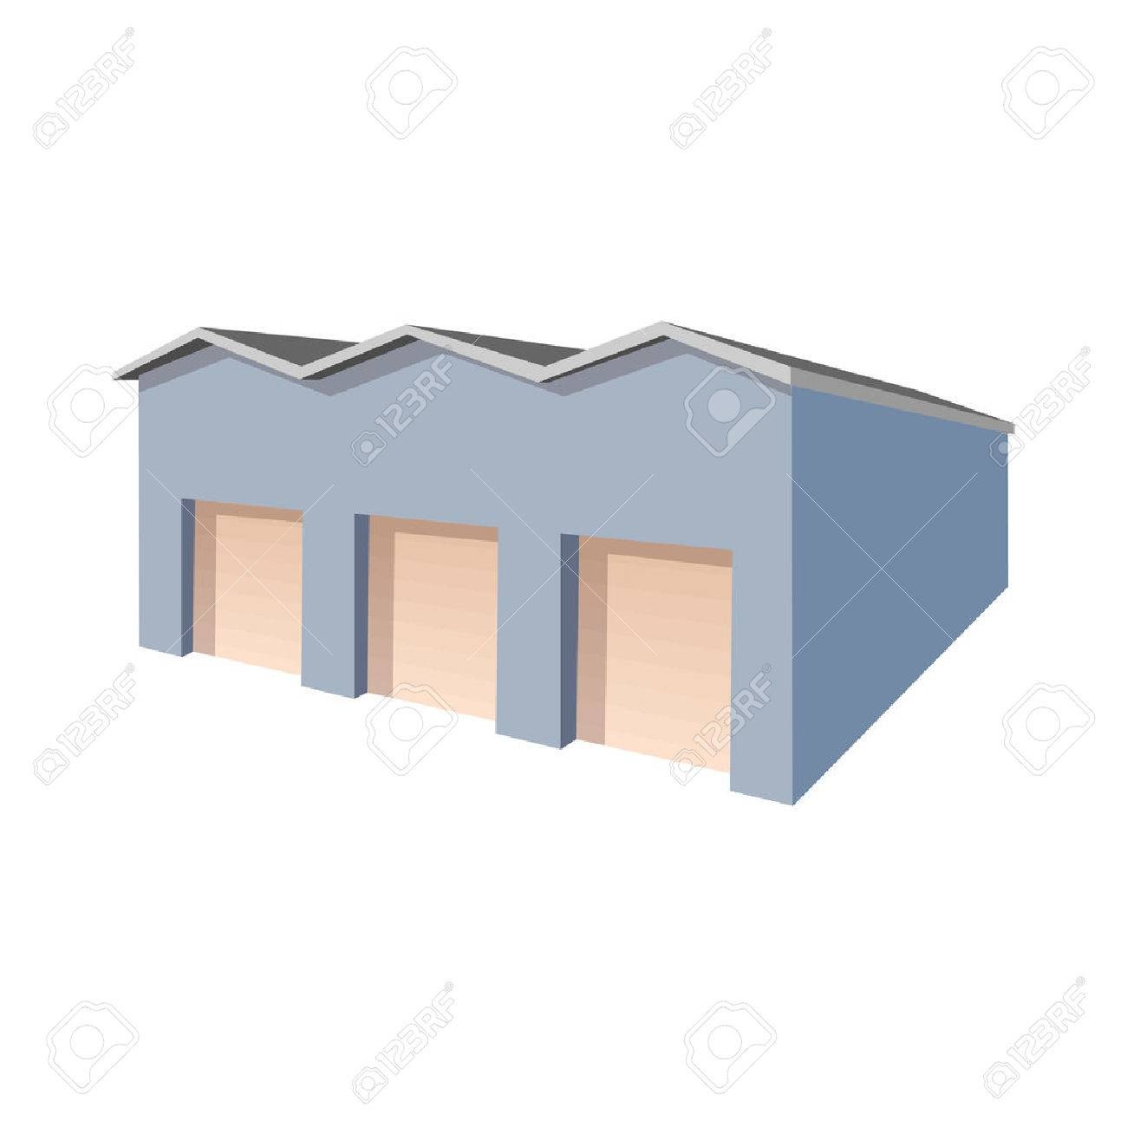
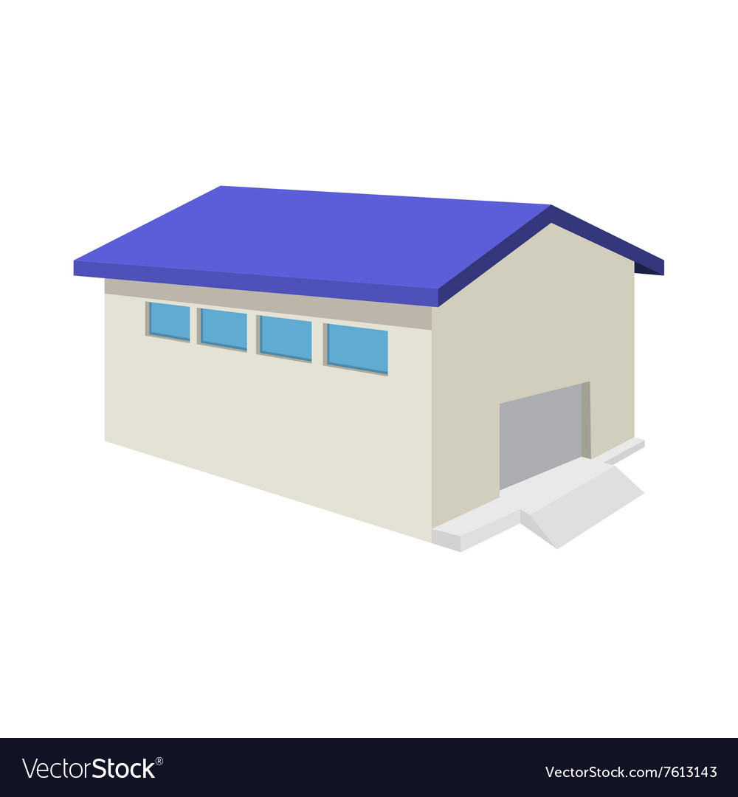
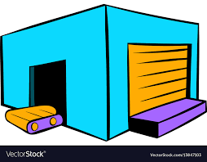

Actual use cases of Knapsack Problems
Logistics Problem in Cainiao (Alibaba) or Amazon:
3-tier shipping logistics: Level-1 Warehouse, Level-2 Warehouse, Forward Warehouse
Level-1 Warehouse: The largest warehouse which are far from customers (5 – 10 in China)
Level-2 Warehouse: Smaller warehouse closer to customers (1-5 per province in China)
Forward Warehouse: Smallest warehouse closest to customers (1-2 per major tier-1 and tier-2 cities in China)
Question: Which items should we put in the forward warehouses?
Each item has a value: the value equals to the improvement in shipping speed in terms of putting it in the forward warehouse than other warehouses.
Each item has a cost: the cost equals to the shipping costs of the item from level-1 or level-2 warehouses to the forward warehouse and the storage costs.
This is exactly a Knapsack problem!
Level-1 Warehouse
Level-2 Warehouse
Forward Warehouse

Slide 14
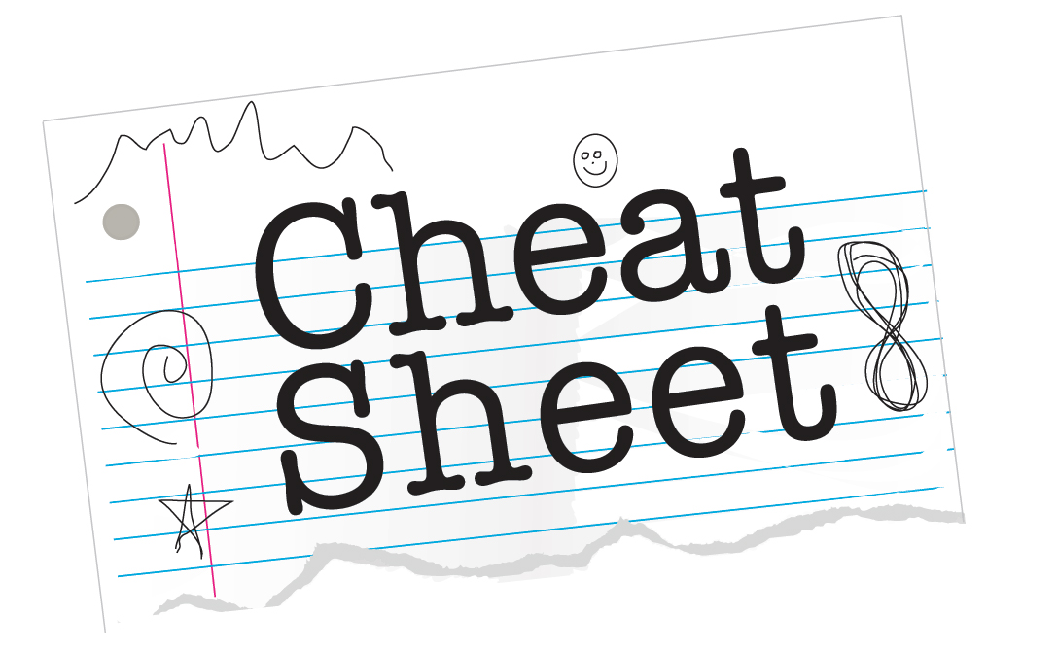
Actual use cases of Knapsack Problems
Creating cheat-sheet for Exams
Each solution or knowledge point:
Has a value: the points of the solution/knowledge point in the exam * the probability that you will not know it if it is not on the cheat sheet
Has a cost: The space it takes to write down this solution or knowledge point

